Slide 1
Ch 4
Greeks
Romans

Slide 2


Mediterranean Empires
800BCE-476BCE
Persian Empire-550BCE
Cyrus the Great then Darius
kind/tolerant
established a large empire
Zoroastrianism
  Similar to some monotheistic ideas (heaven and hell)
Royal Road
  Ran from Western Anatolia to Persian Gulf
  Improved travel from 3mos to 7 days
  Unified the empire
Persian empire was a melting pot…similar to America today

Slide 3

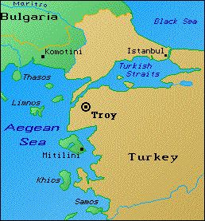
Greece
Mycenae-1400 BCE
  Minoan's lived on Crete, taken over by the Mycenaean's
  Trojan War…did it really happen?
    Who fought? Who won?
    12th century
  Iliad/Odyssey by Homer
    Epic Poems

Slide 4
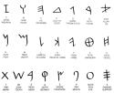


Phoenician-Greek-Alphabet

Slide 5
Geography of Greece
Rocky, mountainous, difficult to unite
City-States emerge
Became active traders
Borrowed their alphabet from the Phoenicians
Greek City-States began competing at the Olympics
  Sparta vs Athens-
  And other city-states (polis)
These two became the two big rivals b/c they both had strong city-states and loyal citizens
1st Olympics-776BCE

Slide 6
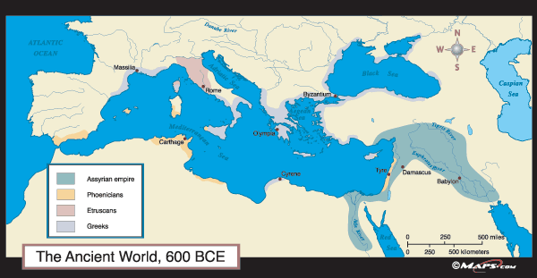

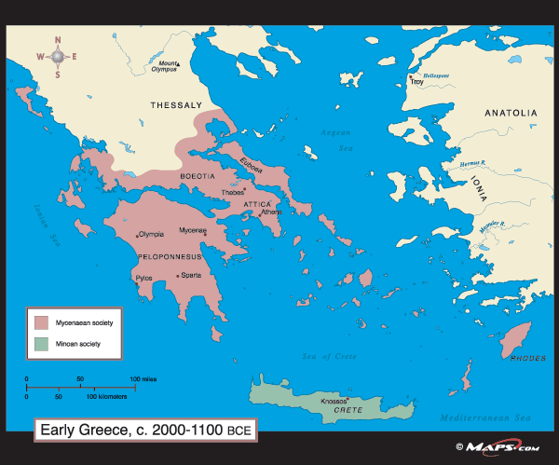
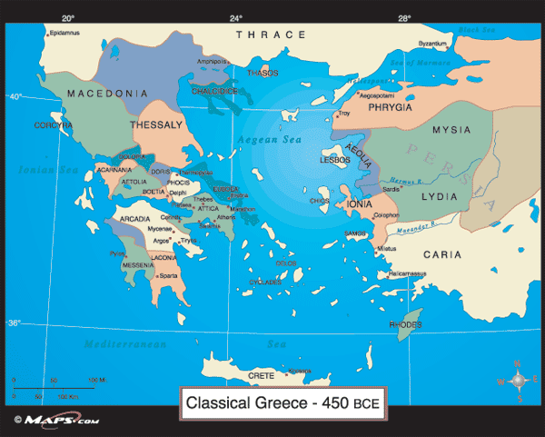

Slide 7

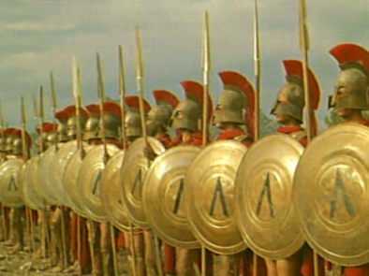
Sparta
Helot uprising was the catalyst for a military society
What was the role of a Spartan male?
  Education of a Spartan male…
    Military school at age 7
What was the role of a Spartan female?
  Infanticide
What did the Spartans value?
Government: Monarchy at times, but often an Oligarchy

Slide 8

Athens
Becomes a democracy…what is a democracy?
Who were considered citizens?
  Free adult men….
Who were not considered citizens?
  Slaves, women, foreigners
Education for men: General Ed. today (math, PE, science, rhetoric)
  Women?
Ostracon
Symposiums

Slide 9

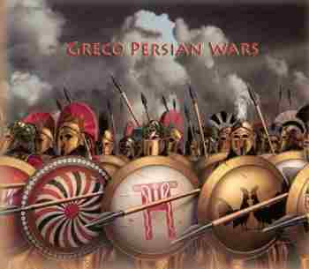

Persian Wars
(War Log)
Darius-Persian King
Ionia-Greek settlement
Vowed revenge!
490BCE-Sent ships to Greece
  1. Marathon
    Phidippides
      Nike!
  2. 10 yrs later…Xerxes and the battle at Thermopylae v. King Leonidas
    300
    Athenian General (Themisticles)….led the navy against Persia
      At the Strait of Salamis

Slide 10


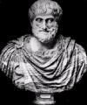

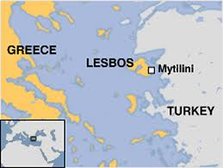
Philosophers/writers
Socrates, Plato, Aristotle(SPA)
  Socratic method
  How did Socrates die?
  What did Plato write?
Theater
  Comedy/tragedy
Sophocles-Oedipus Rex
Sappho- female writer/poet
  Lived on the island of Lesbos

Slide 11
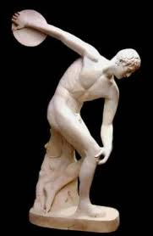
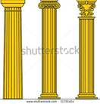
Religion/ Art
Greek Gods and Goddesses (Zeus, Athena, Hera, Aphrodite, etc..)
  Regulated human life; had human characteristics
  Many lower class didn’t feel connected to it; eventually the upper class lost it’s connection as well…they found comfort in philosophy
Hellenistic Era: Stoics (inner discipline)
Art focused on perfection (Parthenon)
  Phidias-sculptor
    Used to be brightly painted…not white
  Monumental structures with columns (Doric, Ionic, Corinthian)
    Called Classical architecture

Slide 12


The Greek Golden Age
(AKA The Age of Pericles)
470-430bce
Ruled for many years by Pericles
Set up the Delian League
  Purpose was to build a navy…they did
  Built the Parthenon with extra $
Peloponnesian War (War Log)
  Sparta vs Athens
  Lasted 27yrs
  Athens hid behind their city walls…problem with this?
  Then Plague sets in 2/3 of Athens dies, including….

Slide 13

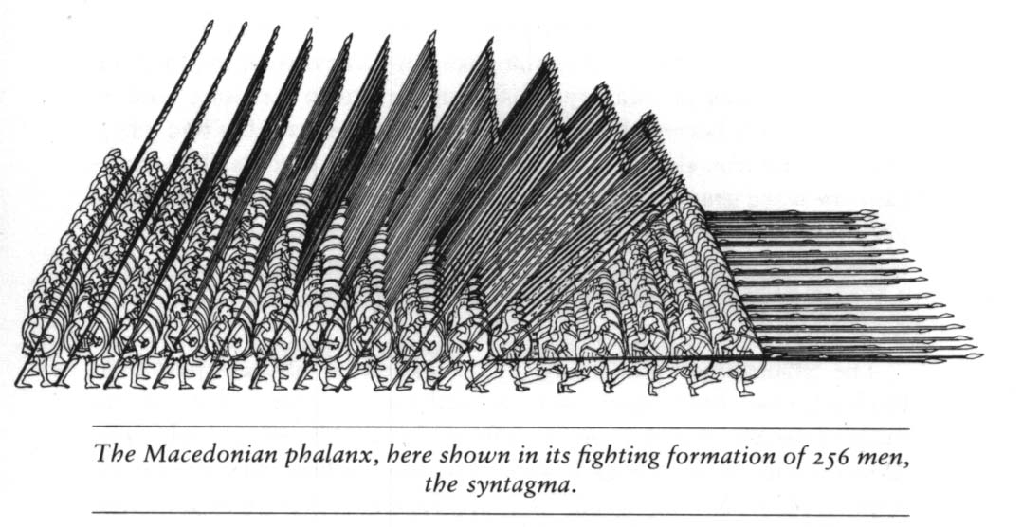
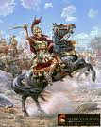
Philip of Macedonia
Sees that Greece is weak, vulnerable
Takes control and extends the Macedonian Empire
  Phalanx formation
He is murdered by a guard at his own daughters wedding….Alexander the Great, his son, takes over…he is only 20 yrs old (336BCE)
Alexander conquers Mesopotamia, Turkey, India from the Persians
  Darius III is leading the Persians

Slide 14
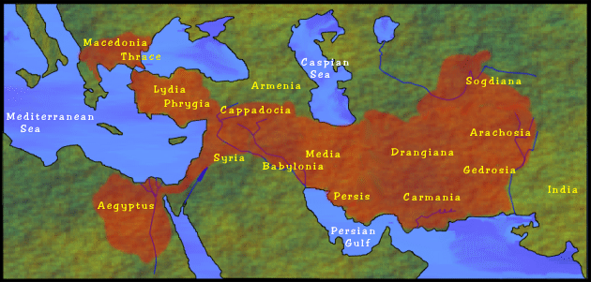
Empire of Alexander the Great born: 356 BCE died:323 BCE

Slide 15
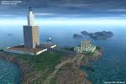
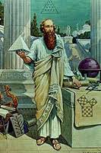

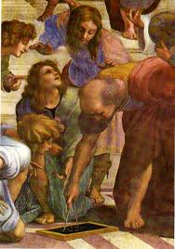
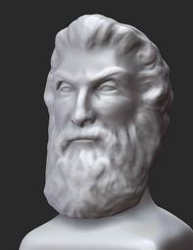
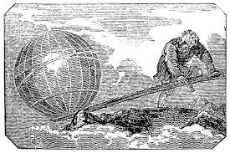
Hellenistic Period
Alexander the Great died at 33 yrs old
Hellenistic was a blend of Persian, Indian, Greek, and Egyptian
Continued the Greek culture in many ways
Created Alexandria in Egypt (and 12 other cities named after himself)
  Library, museum, zoo, botanical gardens, and the Lighthouse (one of the 7 wonders)
Science exploded!
  Aristarchus, Archimedes, Euclid, Pythagoras etc…
Art changed too…more realistic, less perfect

Slide 16
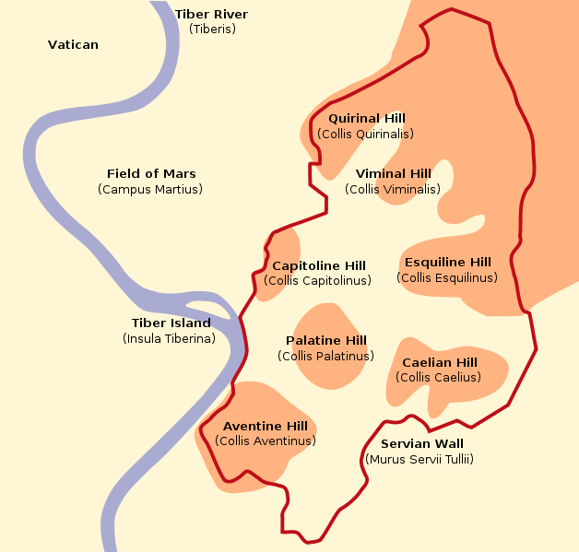
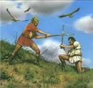
Rome
Began around 800BCE
  7 hills, Romulus and Remus
Descendants of the Etruscans
Created a republic in 509BCE (Tarquin the Proud)
  What is a republic? What do we have in the US?
Had a strong military (Roman Legions)
  Who could serve in the military? Was it an honor or a duty?
Used this might to expand it’s empire
  How did they treat those they conquered? Like the Persians or the Assyrians?
  Looking for good agricultural land
  Trade with Asia? Did anyone want their “stuff”?
  Slave duties: tutoring, worked in mines, road work, etc. but not in the military, that was an honor

Slide 17
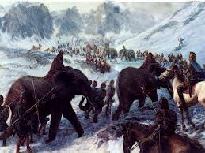
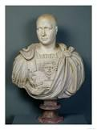
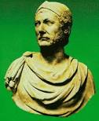
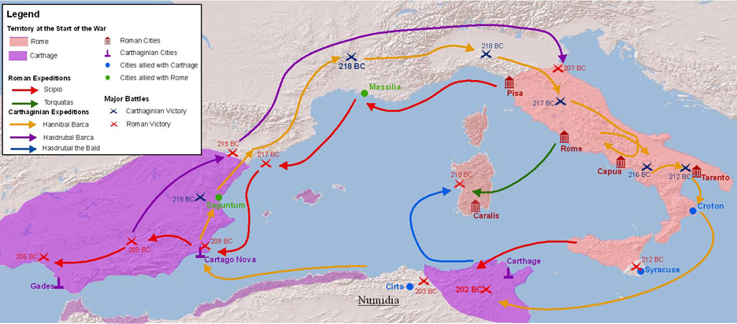
Punic Wars
264-146BCE
Between Rome and Carthage over control of the Mediterranean Sea…Why? Who cares?!?
Three Wars
First one over Sicily for the grain it produced-who won?
Carthage was led by Hannibal during the second
  Used Elephants; went over the Alps…why the long way?
Rome led by Scipio during the Second
  Who won?
Third one: Rome had had enough of Carthage…they ended them forever by doing what?

Slide 18
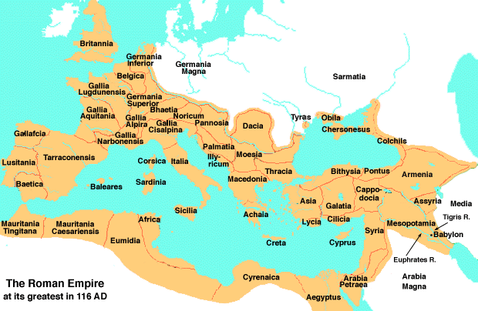
Roman Empire

Slide 19
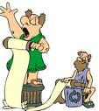
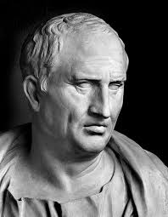
Society
Patricians
  Rich
Plebeians
  Poor
A large gap between the rich and poor
  Poverty increased; ppl moved to the cities; inequitable distribution of land; many farmers had too high of demands placed on them
Women’s Rights?
  Wives of emperors could have power (some ruled while husbands were away)
  They could inherit land and own land, free slaves, run businesses, etc.
Cicero: politician and writer in Rome; wrote about women’s rights and limitations

Slide 20
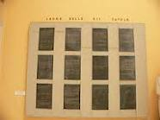

Politics…
12 Tables hung in the Forum
Division of Government
  Legislative, Judicial and Executive Branches
    What do we call this?
  Roman Senate-300; served for life
  2 consuls who shared power, but elected a dictator times of crisis (like what?)
Bread and Circuses-government way to appease the masses
  Many homeless were living in Rome
  Coliseum-held 200,000; Gladiators, Christians, wild animals, etc

Slide 21
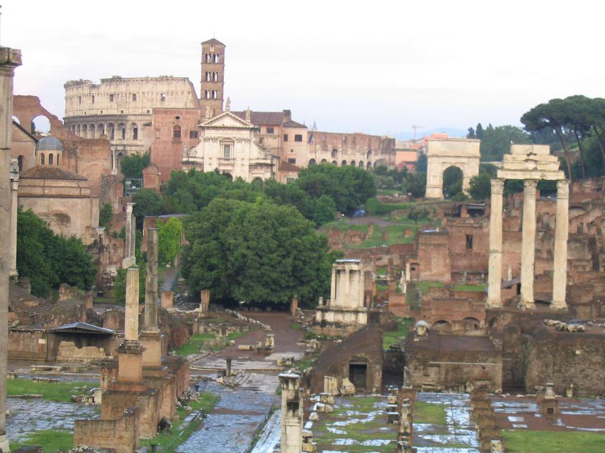
The Forum

Slide 22


Politics and Life…
Republic becomes an Empire
1st Triumvirate-Caesar, Crassus, Pompey
  J. Caesar becomes dictator in 45BCE
    Beware of the Ides of March!
  Murdered by the Senate (Brutus) in 44BCE
2nd Triumvirate-Marc Antony, Octavian, Lepidus
  Octavian/Augustus (grandnephew of Caesar) becomes the dictator in 27BCE-Rome Becomes and EMPIRE!
  The Empire entered a Pax Romana (Roman Peace) for 200yrs of prosperity, common currency to ease trade
  Economy based on agriculture and trade
The title of “Caesar”
Morals were highly valued (During Octavian’s Rule--27BCE)
  Vestal virgins
    Best seats at the Coliseum
Julian Emperors and the Good Emperors
  Tiberius, Caligula, Nero, Claudius (Julian)
  Nerva, Trajan, Marcus Aurelius (Good)

Slide 23
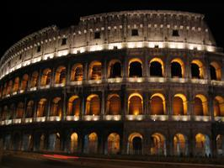
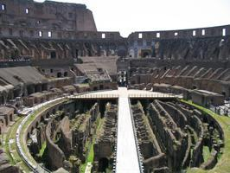
The Coliseum
Shade sails, Naval Battles, Roman Numeral, Plumbing

Slide 24
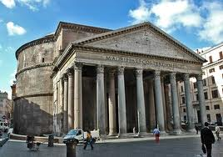
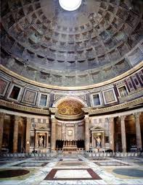
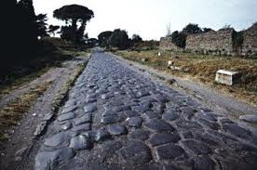
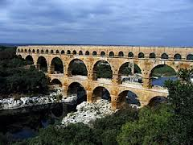
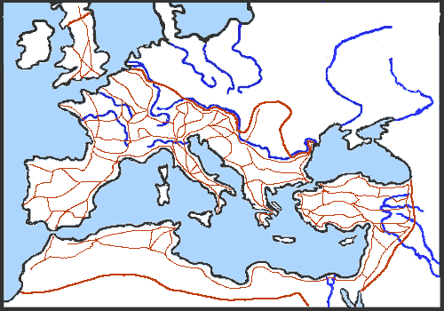
Engineering
Roads
Bridges
Aqueducts
Arches

Slide 25
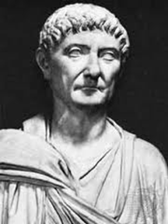
Diocletian divides the empire
Diocletian – 284CE
  ruler of Rome “Divided the empire”
  restored order to the empire
  doubled the size of the army using mercenary soldiers…are these guys loyal?
  Persecuted Christians
  ordered workers to stay in their jobs for life!
  divided Rome into Greek speaking East, and Latin speaking West
  he ruled in the East…why? why not the west?

Slide 26
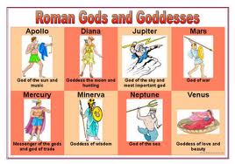
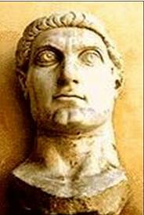
Christianity
Initially there were Roman Gods and Goddesses “borrowed” from the Greeks
Constantine 313CE
  Edict of Milan (legalized Christianity)
  adopted Christianity…how had the Romans treated Christians in the past?
  established a city….what was it? Where was it? He moved the capital there
380CE Theodosius made Christianity the official religion
  The Empire was divided by this time though…made them vulnerable to the Huns

Slide 27
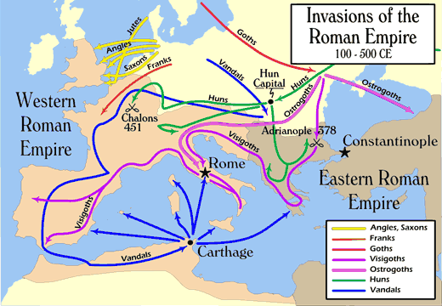
Fall of Rome: 476 CE not just an invasion…
Rome “fell” for 250yrs
Economics-gap between rich and poor, couldn’t provide Bread and Circuses any longer; no more war plunder to fill the Roman “bank accounts”
Military-not loyal any longer (hired mercenaries); couldn’t secure the boarders
Political-dangerous to be emperor; civil war and unrest, capital was in the East (Constantinople)
Social-plague struck, farming population decreased, no one to pay taxes, feed the ppl
Invaded by the Huns, and Germanic tribes: Visigoths, Anglos, Saxons, Vandals, Franks, etc.

Slide 28
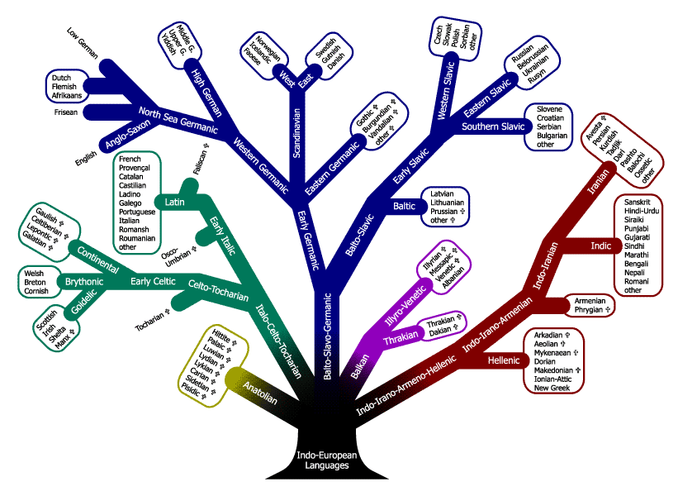

Slide 29
Politics in Both Greece and Rome
It was a good thing to participate in government and it was one’s duty!
  Differences: Democracy v. Republic
Obligation and honor to serve in the military
Many were proud to be part of the great Roman and Greek …AKA Nationalism

